Slide 1
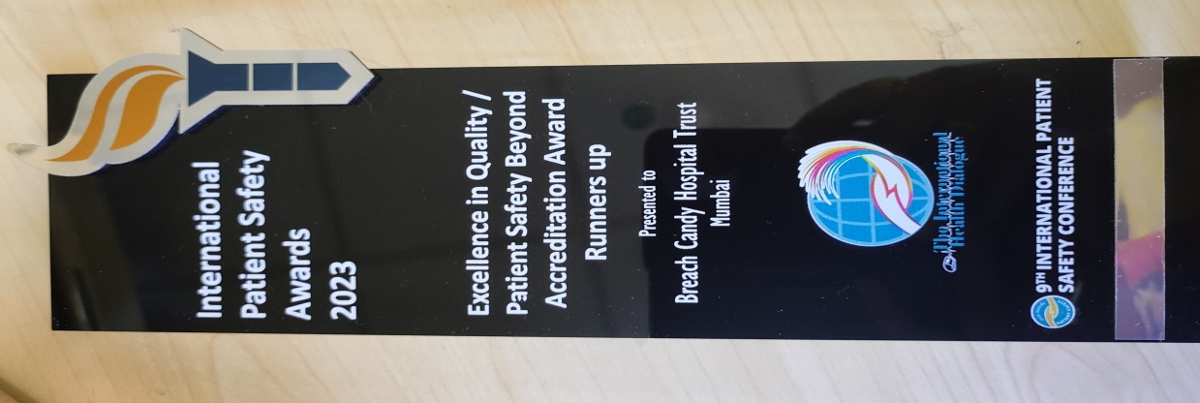
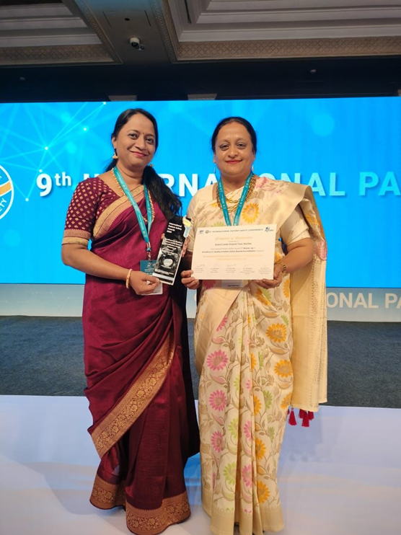
Breach Candy Hospital wins International Patient Safety Award at IPSC ‘23
Breach Candy Hospital wins International Patient Safety Award (IPS)in ‘Safety beyond Accreditation category, for our project of Monitoring and Sustaining Compliance to IPSG using an Checklist based audit tool.
Out of 200 nominations from 70 organizations across India and all around the world ,the panel of judges for the IPS award took into account the aspects of originality, novelty, adaptability, creativity, and sustainability while nominating the winners.
Dr Reshma Shaikh our Chief Patient Safety officer & Ms Shymal Parab (PSN) accepted the Award at the 9th International Patient Safety Conference, 2023 held on 13-14 February, Taj Palace, New Delhi.

Slide 2
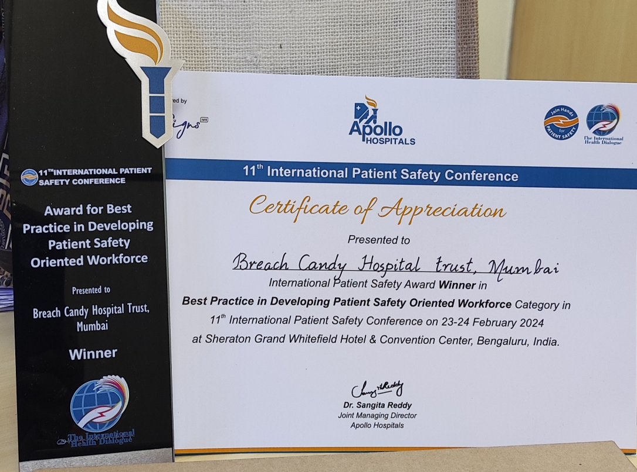
Breach Candy Hospital wins International Patient Safety Award at IPSC ’24
Breach Candy Hospital wins International Patient Safety Award (IPS)in ‘Best Practice in developing Patient Safety Oriented Workforce , for our project of Engage ,Educate & Empower to develop patient safety Champions ‘
Out of 200 nominations from 70 organizations across India and all around the world ,the panel of judges for the IPS award took into account the aspects of originality, novelty, adaptability, creativity, and sustainability while nominating the winners.
Dr Reshma Shaikh our Chief Patient Safety officer accepted the Award at hands of Ms Preetha Reddy ( at 11th International Patient Safety Conference, 2024 held on 23-24February, Sheraton Grand , Bangalore –India

Slide 3
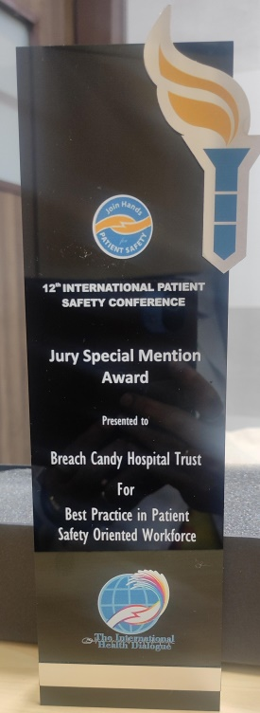
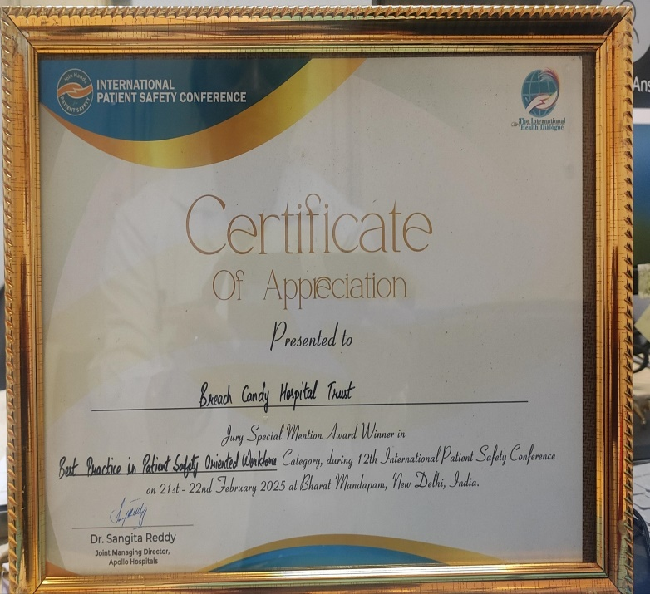
Breach Candy Hospital wins International Patient Safety Award at IPSC 25
Breach Candy Hospital wins International Patient Safety Award (IPS)in ‘Best Practice in developing Patient Safety Oriented Workforce , for our project : Alerts to Action: How effective staff engagement led to easy Adoption to new technology in a tertiary care hospital in Mumbai- India .
Out of 200 nominations from 70 organizations across India and all around the world ,the panel of judges for the IPS award took into account the aspects of originality, novelty, adaptability, creativity, and sustainability while nominating the winners.
Dr Reshma Shaikh our Chief Patient Safety officer accepted the Award at hands of Ms Sangeeta Reddy & Mr Mduduzi Matsebula Honourable Minister of Health –Eswatini ( at 12th International Patient Safety Conference held on 21-22February, Bharat Mandapam New Delhi - India

